Slide 1

Academic Writing
Task 1

Slide 2
IELTS WRITING LESSON 2
1. 复习动态图静态图区分要点及动态描写表达方式
2. 多线图
3. 动态柱图
4. 动态表格
5. 动态饼图
6. 总结

Slide 3
IELTS WRITING LESSON 2
1. 复习动态图静态图区分要点及动态描写表达方式
2. 多线图
3. 动态柱图
4. 动态表格
5. 动态饼图
6. 总结

Slide 4
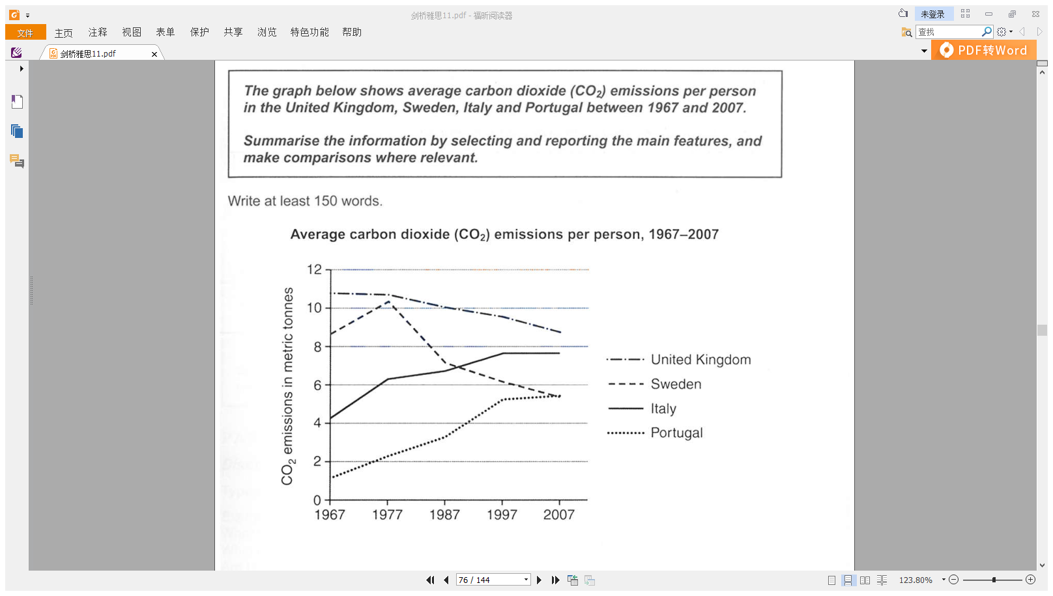
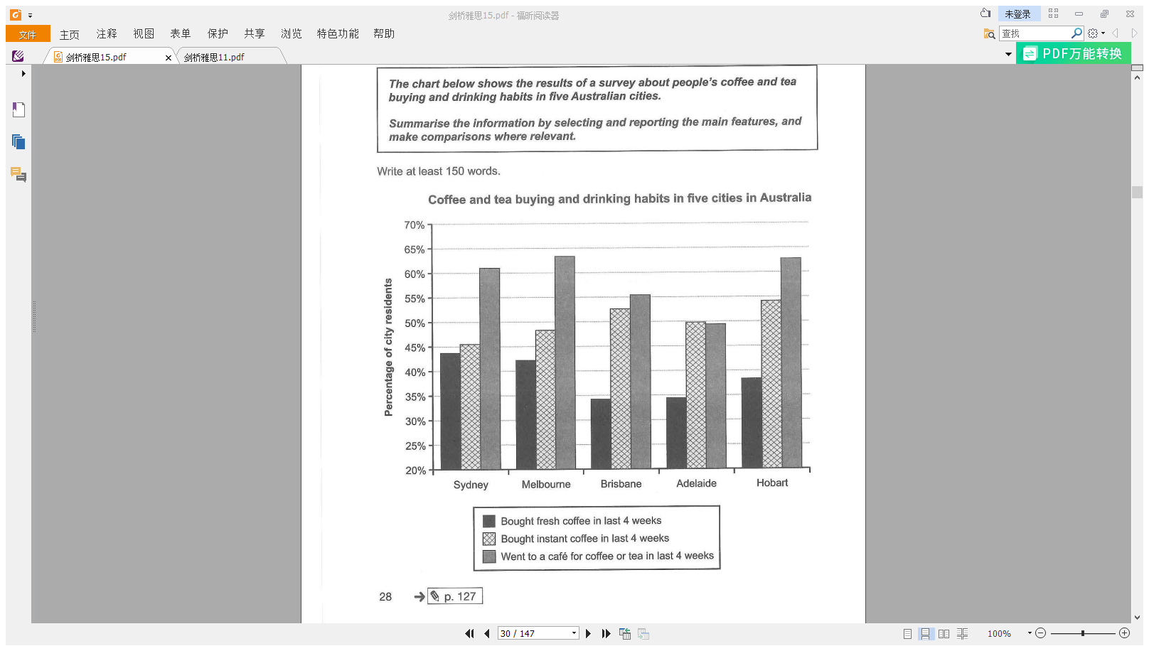
动态图&静态图
有时间变化：有趋势 => 动态图
可能为线图、柱图、饼图、表格
无时间变化：无趋势 => 静态图
可能为柱图、饼图、表格
(C11T2W1)
(C15T1W1)

Slide 5
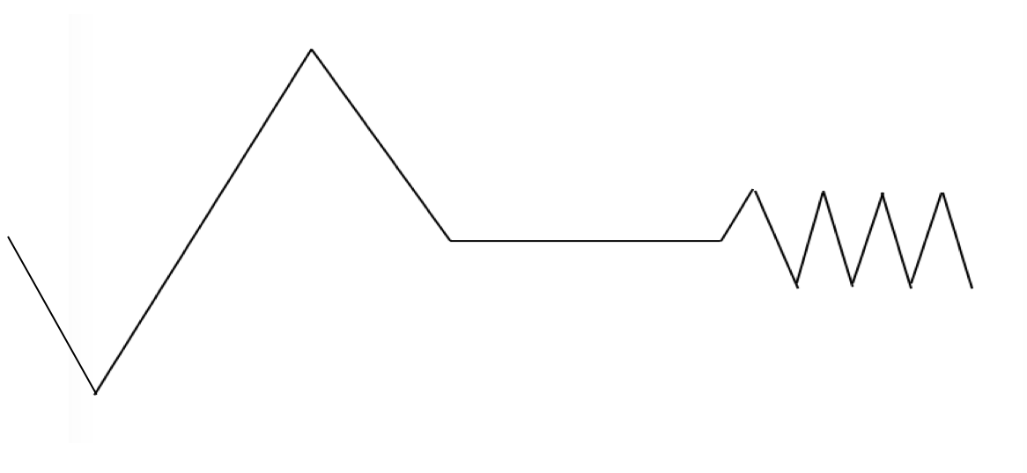
动态图趋势词汇
上升
极值-最高点
保持不变
交点
下降
波动
极值-最低点

Slide 6
动态图基础句型
基础句型：
1. 描述对象+ 趋势(v.)+幅度(adv.) + 数值 + 时间段
2. There be + 趋势(n.)+ 数值 + in 描述对象+ 时间段
3. 趋势(n.) + 数值 + occur/take place（或 be seen/observed/found）+ in 描述对象 + 时间段
4. 时间段 + see/witness/experience + 趋势(n.) + 数值 + in 描述对象

Slide 7
动态图衔接手段
衔接手段：
1. 现在分词作状语：starting at, beginning from（通常可以在描述数据的开头时使用）
2. 表示时间的连词：before, after，后面接完整句子或者现在分词(v-ing)
3. 表示并列and then或转折but的连词
4. 过去分词作状语：followed by + a/an + 幅度形容词+趋势名词
5. 副词：after this, following this period, thereafter, however

Slide 8
IELTS WRITING LESSON 2
1. 复习动态图静态图区分要点及动态描写表达方式
2. 多线图
3. 动态柱图
4. 动态表格
5. 动态饼图
6. 总结

Slide 9
多线图段落结构
总分总结构
段落 | 句数 | 方式
开头段 | 1-2句 | 改写题目
主体段1 | x句 | x为具体数据描写 （挑选重点特征概括，不要流水账式描述）
……
主体段n
结尾段 | 1-2句 | 总结总体趋势/对比特征

Slide 10
多线图段落结构
总分结构
段落 | 句数 | 方式
开头段 | 1-2句 | 改写题目+总结总体趋势/对比特征
主体段1 | x句 | x为具体数据描写 （挑选重点特征概括，不要流水账式描述）
……
主体段n

Slide 11
多线图练习
1. 每个描述对象各一段
描述对象≤3，无脑分段
主体段分段
2. 总趋势相似->放一段
描述对象＞3，观察数据分段
3. 时间点分割

Slide 12
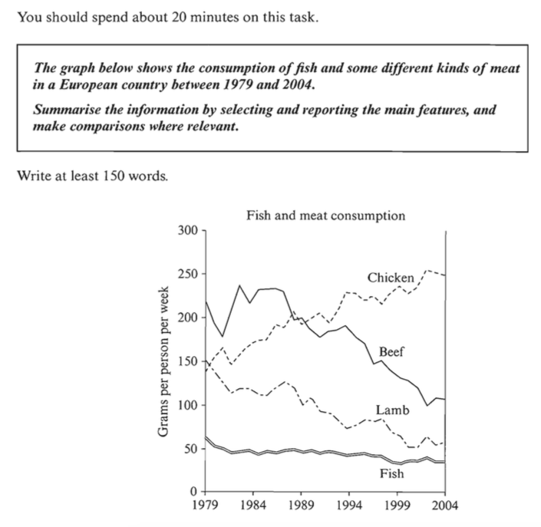
多线图练习
The graph below shows the consumption of fish and some different kinds of meat in a European country between 1979 and 2004.（C7T2）
开头段-改写题目：
The graph illustrates changes in the amounts of beef, lamb, chicken and fish consumed in a particular European country between 1970 and 2004.
Notes:
要点分析：
重要趋势：有3条线总体呈下降趋势，可合并写；chicken呈上升；fish食用量始终最小，变化幅度也最小
特征数据：chicken和lamb起点值差不多；起始点最大、最小值
写明每条线起始点

Slide 13
多线图练习
The graph below shows the consumption of fish and some different kinds of meat in a European country between 1979 and 2004.（C7T2）
总趋势相似->放一段（描述对象>3）
chicken
Beef & Lamb
Fish

Slide 14
多线图练习
The graph below shows the consumption of fish and some different kinds of meat in a European country between 1979 and 2004.（C7T2）
主体段1
In 1979 beef was by far the most popular of these foods, with about 225 grams consumed per person per week. Lamb and chicken were eaten in similar quantities (around 150 grams), while much less fish was consumed (just over 50 grams).

Slide 15
多线图练习
The graph below shows the consumption of fish and some different kinds of meat in a European country between 1979 and 2004.（C7T2）
主体段2
However, during this 25-year period the consumption of beef and lamb fell dramatically to approximately 100 grams and 55 grams respectively. The consumption of fish also declined, but much less significantly to just below 50 grams, so although it remained the least popular food, consumption levels were the most stable.

Slide 16
多线图练习
The graph below shows the consumption of fish and some different kinds of meat in a European country between 1979 and 2004.（C7T2）
主体段3
The consumption of chicken, on the other hand, showed an upward trend, overtaking that of lamb in 1980 and that of beef in 1989. By 2004 it had soared to almost 250 grams per person per week.

Slide 17
多线图练习
The graph below shows the consumption of fish and some different kinds of meat in a European country between 1979 and 2004.（C7T2）
结尾段
Overall, the graph shows how the consumption of chicken increased dramatically while the popularity of these other foods decreased over the period.

Slide 18
IELTS WRITING LESSON 2
1. 复习动态图静态图区分要点及动态描写表达方式
2. 多线图
3. 动态柱图
4. 动态表格
5. 动态饼图
6. 总结

Slide 19
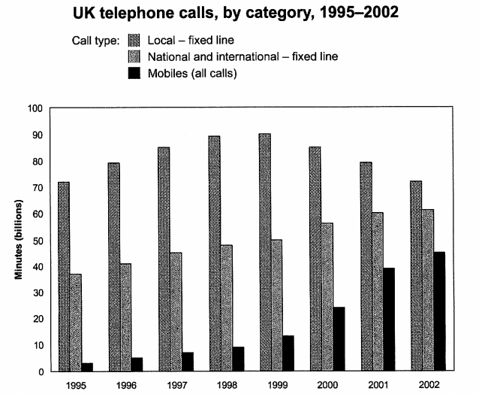
动态柱图练习
The chart below shows the total number of minutes (in billions) of telephone calls in the UK, divided into three categories, from 1995-2002.
（C9T2）
每个描述对象各一段(描述对象≤3)

Slide 20
动态柱图练习
The chart below shows the total number of minutes (in billions) of telephone calls in the UK, divided into three categories, from 1995-2002.
开头段-改写题目：
The chart shows the time spent by UK residents on different types of telephone calls between 1995 and 2002.

Slide 21
动态柱图练习
B1：local-fixed line
始终最大，1995-1998年逐步上升，1999年小幅度上升到最高点后，2002年回落至1995年的数值。
Local fixed line calls were the highest throughout the period, rising from 72 billion minutes in 1995 to just under 90 billion in 1998. After peaking at 90 billion the following year, these calls had fallen back to the 1995 figure by 2002.

Slide 22
句型补充：
描述对象（主语）+ 谓语...，v-ing(趋势)+数值+时间
Local fixed line calls were the highest throughout the period. Local fixed line calls rose from 72 billion minutes in 1995 to just under 90 billion in 1998.
Local fixed line calls were the highest throughout the period, Local fixed line calls rising from 72 billion minutes in 1995 to just under 90 billion in 1998.

Slide 23
动态柱图练习
B2：national and international fixed line calls
1995-2001年逐步上升，2001-2002小幅度上升
National and international fixed line calls grew steadily from 38 billion to 61 billion at the end of the period, though the growth slowed over the last two years.

Slide 24
动态柱图练习
B3：mobiles
也上升，但是更加剧烈，1995-1999年，小幅度上升，1999-2002年大幅度上升
There was a dramatic increase in mobile calls from 2 billion to 46 billion minutes. This rise was particularly noticeable between 1999 and 2002, during which time the use of mobile phones tripled.

Slide 25
词汇补充：
1. double ; triple；halve (动词）
e.g. The number of … doubled during the decade.
The number of ... more than tripled in 2000.
The number halved in 1999.
2. two-fold / three-fold / four-fold …(形容词）
e.g. There was a two-fold increase in retail sales.

Slide 26
动态柱图练习
结尾段（总结趋势；比较大小）
虽然local fixed line在2002年仍最受欢迎，但这三种calls差距显著缩小了。
To sum up, although local fixed line calls were still the most popular in 2002, the gap between the three categories had narrowed considerably over the second half of the period.

Slide 27
句型补充：
The gap between 描述对象+ narrow/widen+幅度(adv.)+时间段
, the gap between the three categories had narrowed considerably over the second half of the period.

Slide 28
IELTS WRITING LESSON 2
1. 复习动态图静态图区分要点及动态描写表达方式
2. 多线图
3. 动态柱图
4. 动态表格
5. 动态饼图
6. 总结

Slide 29
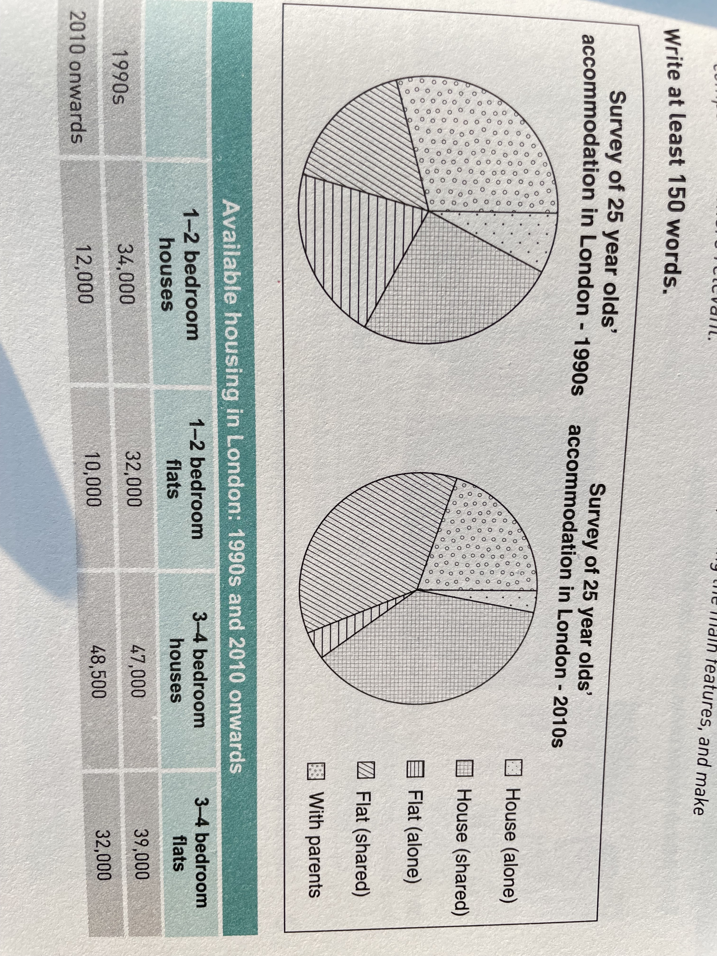
动态饼图和表格练习
（胡敏雅思7代-写作基础版p73）
shared
alone
with parents
1-2 bedroom
3-4 bedroom

Slide 30
动态饼图和表格练习
（胡敏雅思7代-写作基础版p73）
首段：题目改写+总结数据特征
The pie charts and table show 25-year-old accommodation and the availability of different types of housing in London in the 1990s and 2010s. Since 2010 the lower number of available 1-2 bedroom houses and flats has reduced the housing choices for this age group.

Slide 31
动态饼图和表格练习
主体段 1：
Shared accommodation has become the most common form of housing for this age group in the 2010s. In the 1990s, only around 50% of those lived in shared houses or flats. In the 2010s this number has grown to around 75%.The higher number could be due to the stable availability of larger houses and flats during this period.

Slide 32
动态饼图和表格练习
主体段2：
There was a drop in the number of people living alone. In the 1990s around a quarter of 25-year-olds lived alone in London. However, from 2010 onwards, the reduction in the availability of 1-2 bedroom houses and flats has altered this figure. In the 1990s there were 34,000 1-2 bedroom houses and 32,000 1-2 bedroom flats available, before these figures dropped to 12,000 and 10,000 respectively.

Slide 33
动态饼图和表格练习
主体段3:
Finally, living with parents has become less common. There was a reduction in the number of 25-year-olds living with parents from around a third in the 1990s to under a quarter in 2010s.

Slide 34
IELTS WRITING LESSON 2
1. 复习动态图静态图区分要点及动态描写表达方式
2. 多线图
3. 动态柱图
4. 动态表格
5. 动态饼图
6. 总结

Slide 35
动态图重难点
1. 段落结构：总-分-总；总-分
2. 主体段分段思路（描述对象是否大于3）
3. 动态图补充词汇和句型
4. 不同图表特征差异

Slide 36
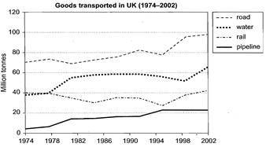
HOMEWORK
The graph below shows the quantities of goods transported in the UK between 1974 and 2002 by four different modes of transport. (C8T4)
完成一篇完整的小作文
要求：
1.分段描述数据
2.灵活运用不同词汇句型
3.概括信息/分析重点

